Slide 1
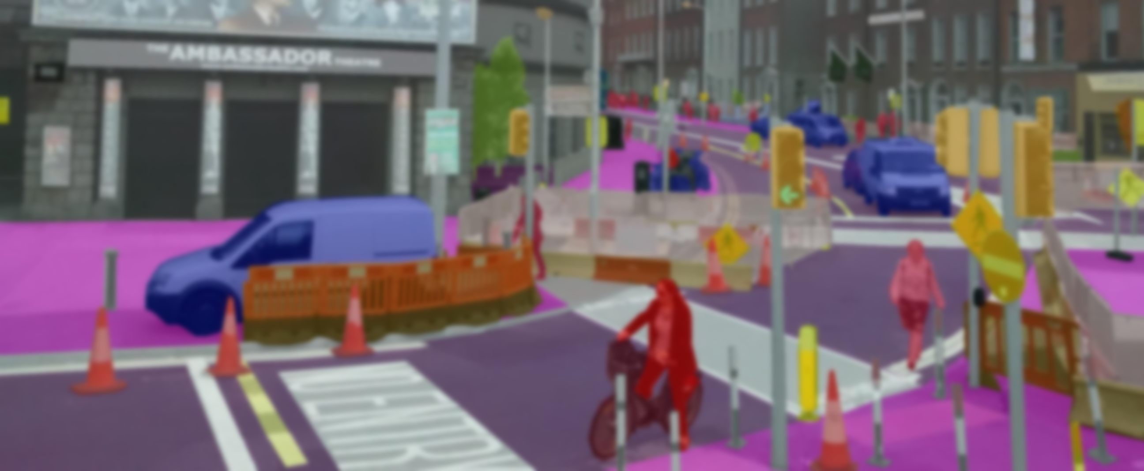

Indian Institute of Information Technology Nagpur
Dept: Electronics and Communication Engineering
Sematic Image Segmentation
using Conditional Adversarial Network
Submitted To- Dr. Tapan Kumar Jain
Assistant Professor,
Department of Electronics
and Communication Engineering
Presented By- Pratik Adle
Aditya Kotasthane
Darpan Sarode
Mayur Raul
Ambuj Yadav

Slide 2
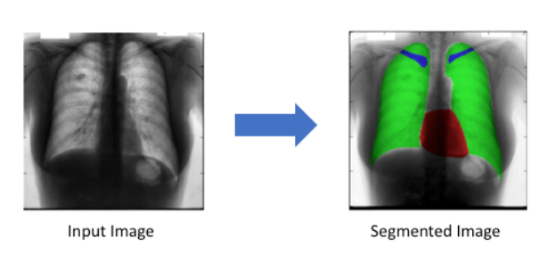
Sematic Image Segmentation
using Conditional Adversarial Networks
Problem Statement:
Semantic segmentation models are very useful in variety of tasks such as :
Autonomous vehicles
Medical image diagnostics
Most of the object detection techniques involve deep learning and artificial intelligence.
However these require large data sets and resources.
2

Slide 3
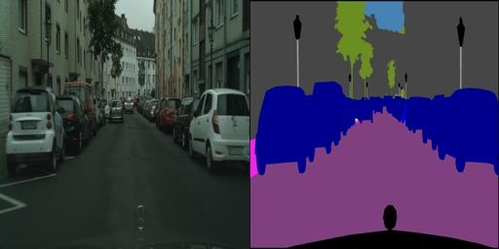
Sematic Image Segmentation
using Conditional Adversarial Networks
Objective:
Our objective is to implement Semantic segmentation model using conditional Generative Adversarial Network
We predict the output image based on the ground truth image available in the dataset
To learn spatial object distributions, for example, roads are at the bottom of images, etc.
3

Slide 4
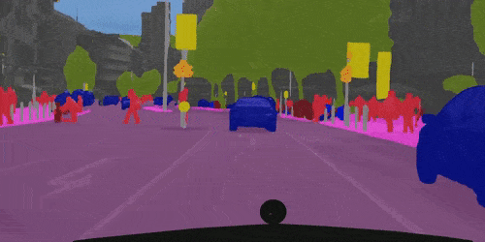
Sematic Image Segmentation
using Conditional Adversarial Networks
Introduction:
Semantic segmentation is a visual scene understanding task which can be formulated as a dense labelling problem, where the goal is to predict a category label at each pixel in the input image
CNN’s learn to minimize a loss function – an objective that scores the quality of results – and although the learning process in CNN is automatic, a lot of manual effort is still required for designing effective losses. In other words, we still have to tell the CNN what we wish it to minimize which is an open problem and generally requires expert knowledge.
We make the output indistinguishable from reality and then automatically learn a loss function appropriate for satisfying this goal. This is done using Generative Adversarial Networks (GANs).
GANs learn a loss that tries to classify if the output image is real or fake and simultaneously trains a generative model to minimize this loss
Conditional GANs is suitable for image-to-image translation tasks, where we put a condition on an input image and generate a corresponding output image.
The adversarial term encourages the segmentation model to produce label maps that cannot be differentiated from ground truth maps by an adversarial binary classification model. Since the adversarial model can assess the joint configuration of many label variables, it can enforce forms of higher-order consistency that cannot be enforced using pair-wise terms, nor measured by a per-pixel cross-entropy loss
Our primary contribution is to demonstrate that on a wide variety of problems, conditional GANs (cGANs) produce reasonable results. Our second contribution is to present a framework that is sufficient to achieve good results.
4

Slide 5
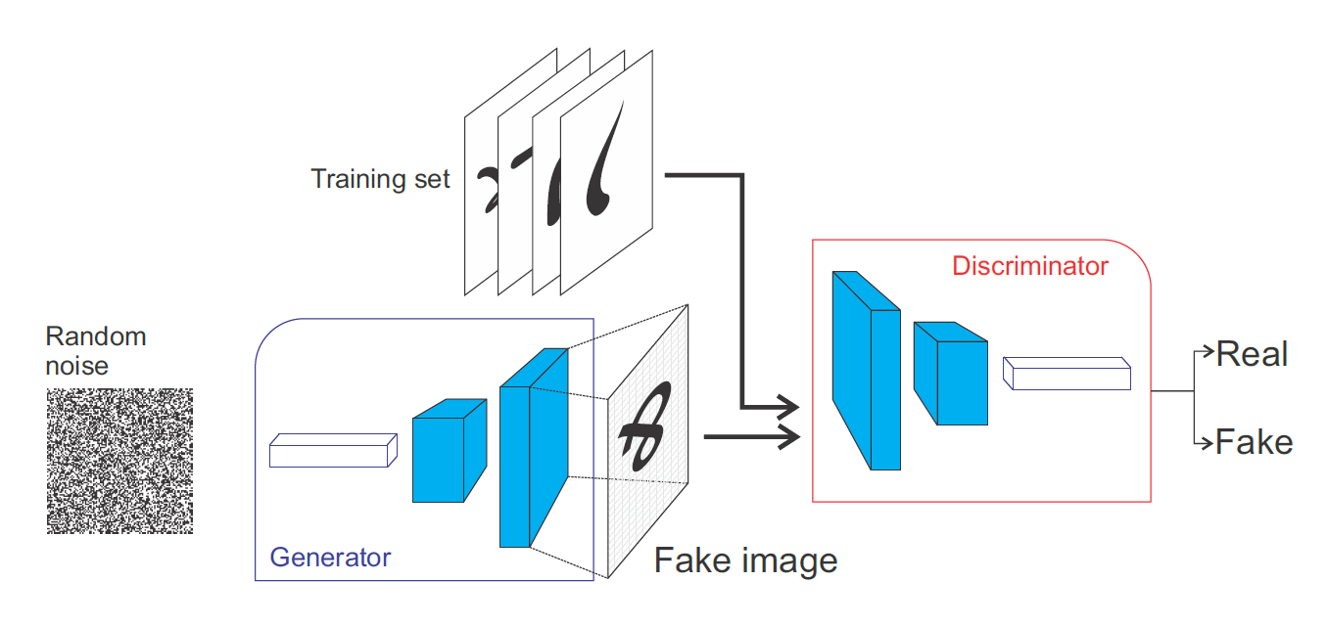
Conditional Generative Adversarial Networks:
To tackle the limitations of current methods, we have used GANs for semantic segmentation to leverage freely available data and additional data to improve the fully supervised methods.
These generative methods have been largely been used in unsupervised and semi-supervised learning for visual classification tasks and very little has been done for semantic segmentation.
This GAN aims at creating probability maps for each class for a given image, then the discriminator is used to distinguish between generated maps and ground truth. Our method is different from this method as
we let the discriminator find the labels of pixels,
we leverage unlabeled data alongside generated data in an adversarial manner to compete in getting labels and
we use conditional GAN to enhance the quality of generated samples for better segmentation performance as well as to make GAN training more stable. Prior to this work the conditioned GANs has been on discrete labels , text , and, indeed, images.
Several other papers have also used GANs for image-to-image mappings but only applied the GAN unconditionally, relying on other terms (such as L2 regression) to force the output to be conditioned on the input. These methods were tailored for
a specific application. Our framework differs in that nothing
is application-specific. This makes our setup considerably
simpler than most others
5

Slide 6
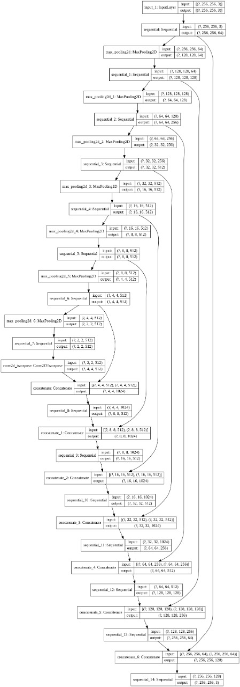
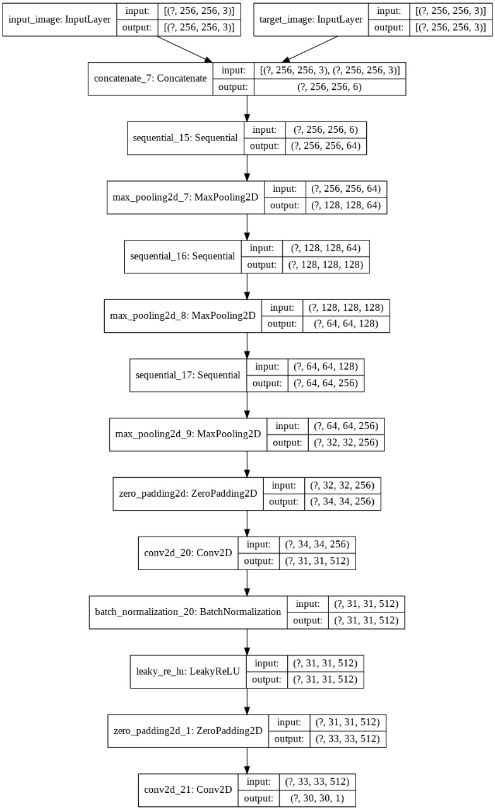
Architecture of Model
Generator Architecture
Discriminator Architecture
6

Slide 7
Dataset Used
In this experiment we used the Cityscapes Dataset that focuses on semantic understanding of urban street scenes. Cityscapes Dataset consists of labeled videos taken from vehicles driven in Germany. The dataset has still images from the original videos, and the semantic segmentation labels are shown in images alongside the original image. This is one of the best datasets around for semantic segmentation tasks.
The Cityscapes Dataset consists of:
2975 training images ﬁles and 500 validation image ﬁles.
Each image ﬁle is 256x512 pixels.
Each image ﬁle consists of original photo on the left half of the image and output of semantic segmentation on the right half (labelled image).
7

Slide 8
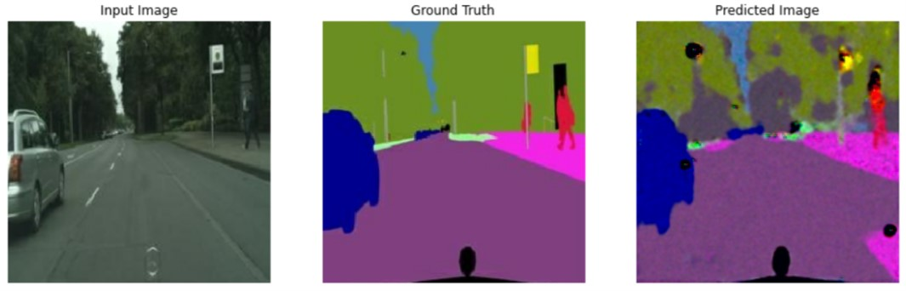
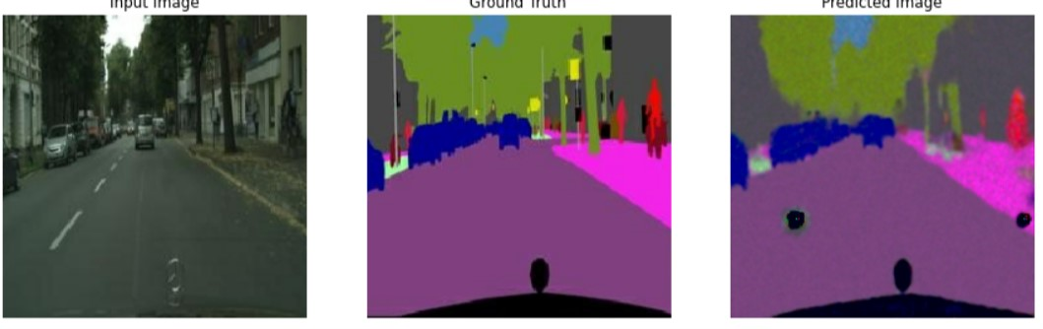
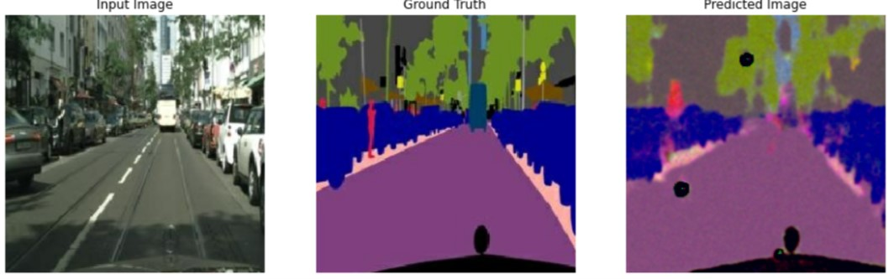
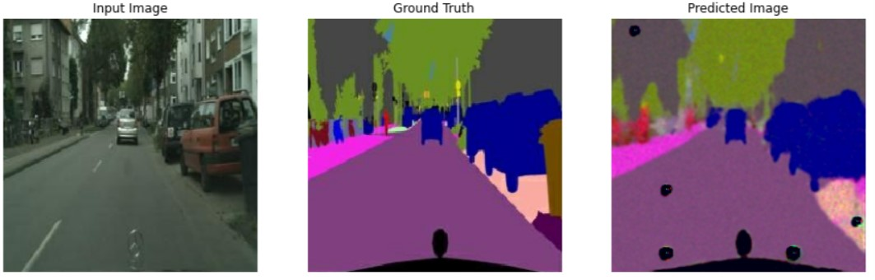
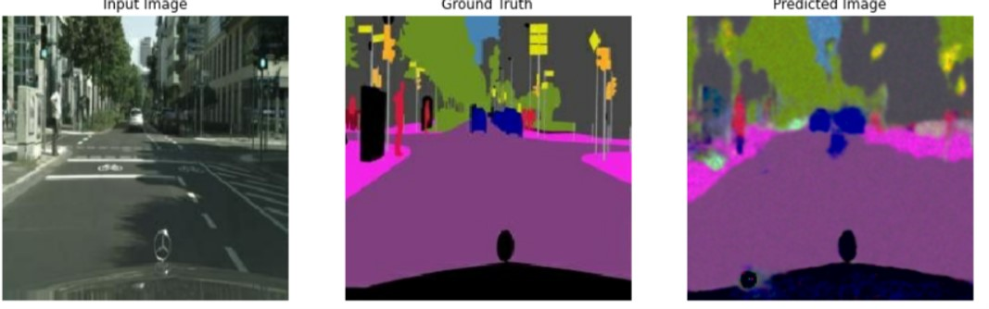
EXPERIMENTAL RESULTS
Our network was able to learn hidden structures that are then used to enhance the performance of our GAN discriminator
Moreover, our conditional GAN framework was able to learn spatial object distributions, for example, roads are at the bottom of images, etc.
The Results achieved in this experiment indicate that the extra data provided through adversarial loss boosts the performance of sematic segmentation.
The Discriminator and the Generator not only generates images but it also amounts to learning meaningful features for pixel classification
8

Slide 9
Conclusion
The results in this paper suggest that the conditional adversarial networks are a promising approach for many image-to image translation tasks.
These networks learn a loss adapted to the task and data which makes them applicable in a wide variety of settings. We conducted the experiments on the Cityscapes Dataset.
The result shows that the adversarial training approach leads to improvements in semantic segmentation accuracy.
9

Slide 10
References
[1] A. v. d. H. G. Lin, C. Shen and I. Reid, “Efficient piecewise training of
deep structured models for semantic segmentation,” CVPR, 2016.
[2] P. Y. M. Mostajabi and G. Shakhnarovich, “Feedforward semantic
segmentation with zoom-out features,” In Proceedings of the IEEE
Conference on Computer Vision and Pattern Recognition, p. 3376–3385,
2015.
[3] L. N. C. Farabet, C. Couprie and Y. LeCun, “Learning hierarchical
features for scene labeling.,” IEEE transactions on pattern analysis and
machine intelligence, vol. 35, no. 8, p. 1915– 1929, 2013.
[4] E. S. J. Long and T. Darrell, “Fully convolutional networks for semantic
segmentation,” In Proceedings of the IEEE Conference on Computer
Vision and Pattern Recognition, p. 3431–3440, 2015.
[5] E. S. J. Long and T. Darrell, “Fully convolutional networks for semantic
segmentation,” CVPR, 2015.
[6] A. S. E. Denton, S. Chintala and R. Fergus, “Deep generative image
models using a laplacian pyramid of adversarial networks,” NIPS, 2015.
[7] X. Y. L. L. B. S. S. Reed, Z. Akata and H. Lee, “Generative adversarial
text to image synthesis,” ICML, 2016.
[8] T. Z. Phillip Isola, Jun-Yan Zhu and A. A. Efros, “Image-to-image
translation with conditional adversarial networks,” arXiv:1611.07004v3,
2018.
[9] S. C. Pauline Luc, Camille Couprie, “Semantic segmentation using
adversarial networks,” arXiv:1611.08408, 2016.
[10] P. F. O. Ronneberger and T. Brox, “U-net: Convolutional networks for
biomedical image segmentation,” MICCAI, 2015.
[11] L. M. A. Radford and S. Chintala, “Unsupervised representation learning
with deep convolutional generative adversarial networks,” ICLR, 2016.
[12] S. Ioffe and C. Szegedy, “Batch normalization: Accelerating deep
network training by reducing internal covariate shift,” ICML.
[13] J. D. T. D. D. Pathak, P. Krahenbuhl and A. A. Efros, “Context encoders:
Feature learning by inpainting,” CVPR, 2016.
[14] X. Wang and A. Gupta, “Generative image modeling using style and
structure adversarial networks,” ECCV, 2016.
[15] S. K. S. A. B. L. Larsen and O. Winther, “Autoencoding beyond pixels
using a learned similarity metric,” ICML, 2016.
[16] C. Li and M. Wand, “Precomputed real-time texture synthesis with
markovian generative adversarial networks,” ECCV, 2016.
[17] A. A. Efros and T. K. Leung, “Texture synthesis by nonparametric
sampling,” ICCV, 1999.
[18] A. A. Efros and W. T. Freeman, “Image quilting for texture synthesis
and transfer,” SIGGRAPH, 2001.
10

Slide 11

11

